Slide 1
Digitisation and the new rider journey
Encouraging and enabling safer journeys to school

Slide 2
Introduction
Jessica Nelson
Head of Promotion and Communications

Slide 3
What are the 3 phases of the new rider journey?

Slide 4
Consistent pre-course information

Slide 5
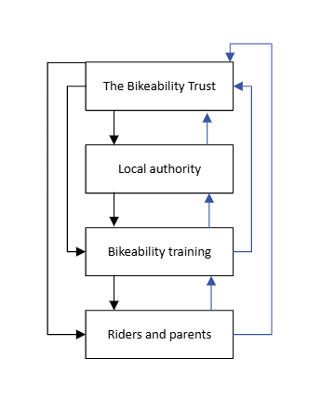
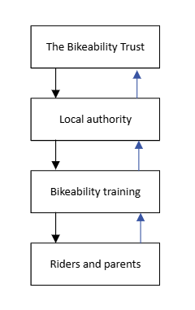
Original
Digitisation

Slide 6
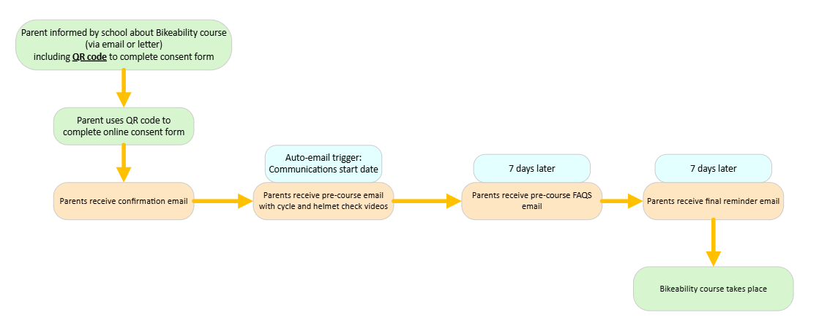
Pre-Course Communications Journey

Slide 7
Pre-Course Information

Slide 8
2. Digital post-course feedback and ongoing engagement

Slide 9
Post-Course Communications Journey

Slide 10
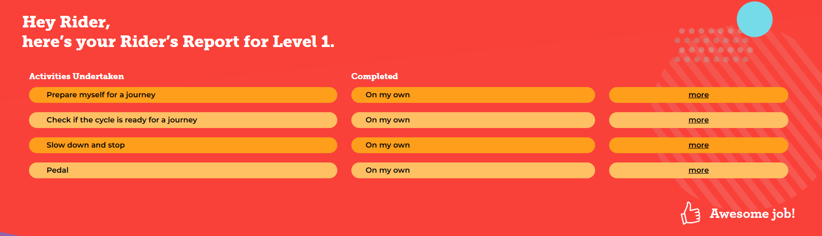
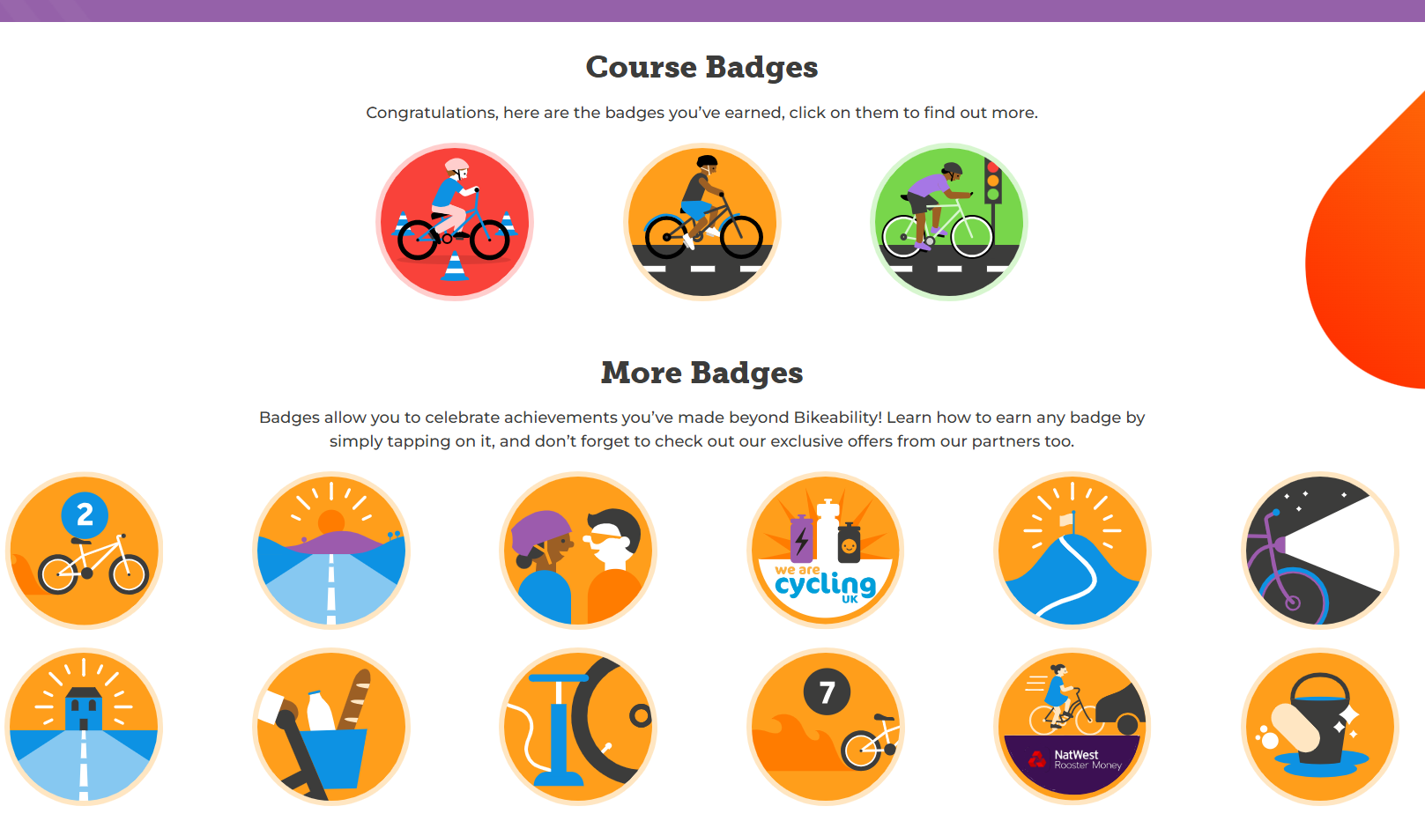

Slide 12
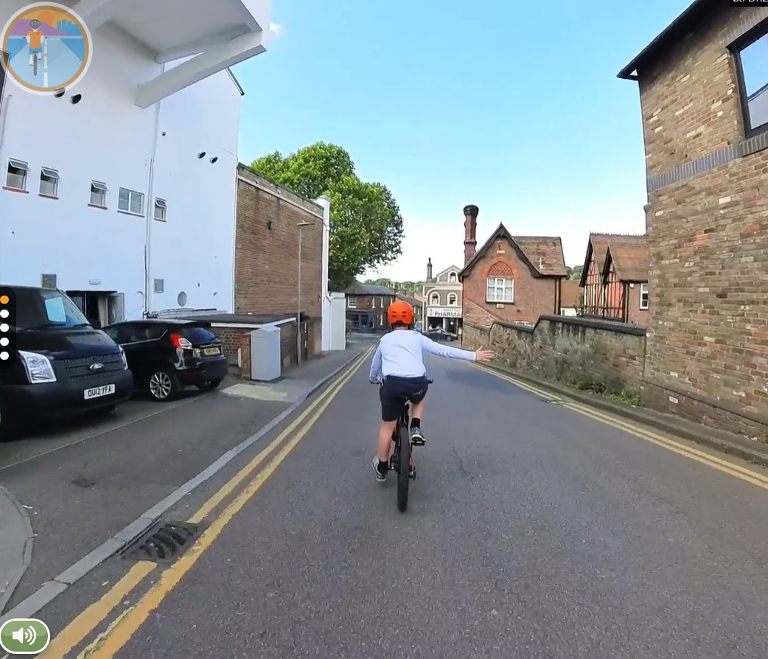
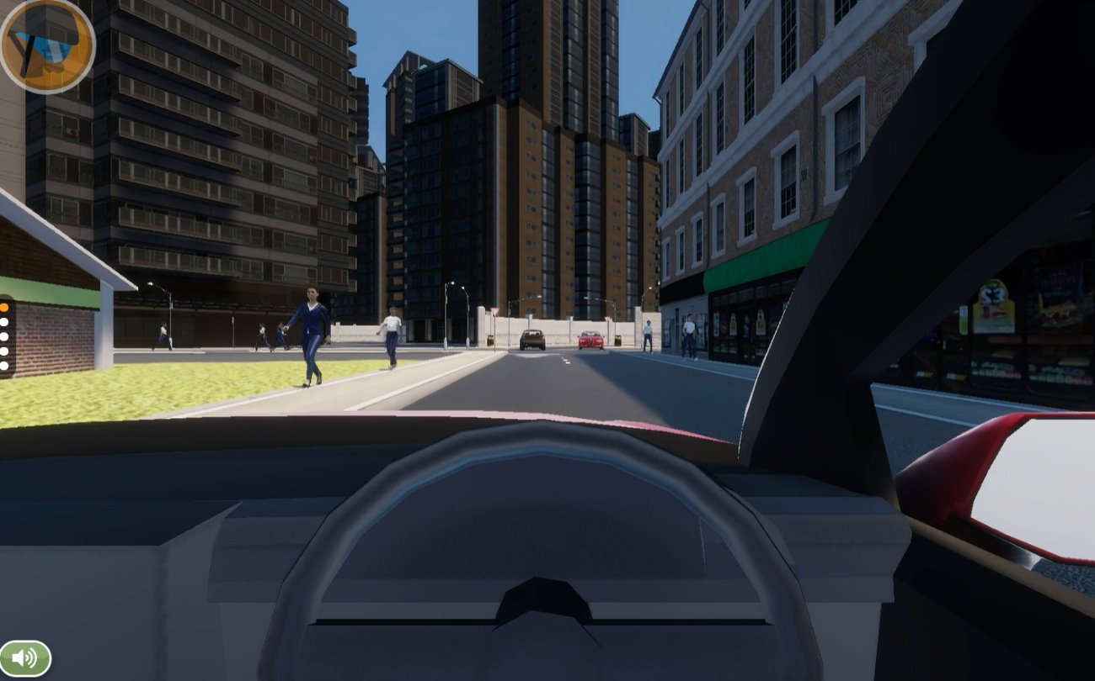
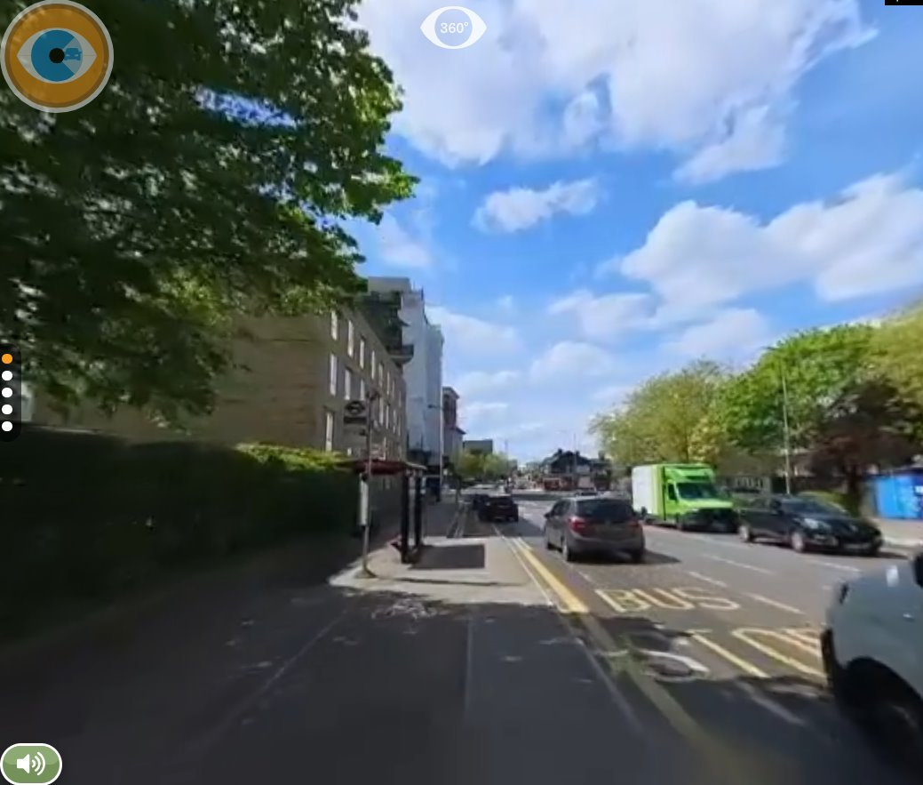
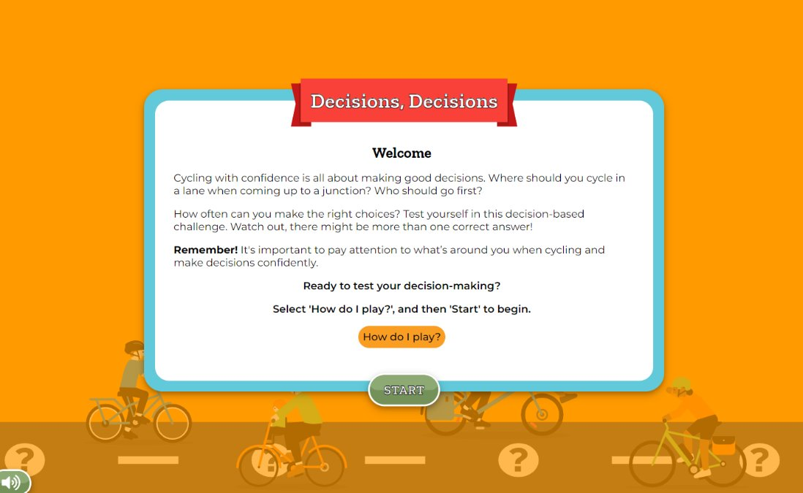

Slide 13
3. Measuring Impact

Slide 15
Next Steps

Slide 16
Next Steps
Us:
Review and amend emails, based on feedback
Update documentation to include template email content
Review response rates, and amend approach as required
Continue to gather data and build evidence case for Bikeability
You:
Purchase new award materials
Start using digitisation
Help promote Bikeability Club to children who have gone through digitised route

Slide 17
For any digitisation queries, please contact
system-admin@bikeabilitytrust.org

